Slide 1
Financial Modeling
WACC, Weighted Average Cost of Capital
Jacqueline Garner, Ph.D.
Lecturer
Scheller College of Business
WACC, Weighted Average Cost of Capital
Notes:
Hello, I’m Jacqueline Garner, and welcome to Financial Modeling

Slide 2
Before We Begin…

Slide 3
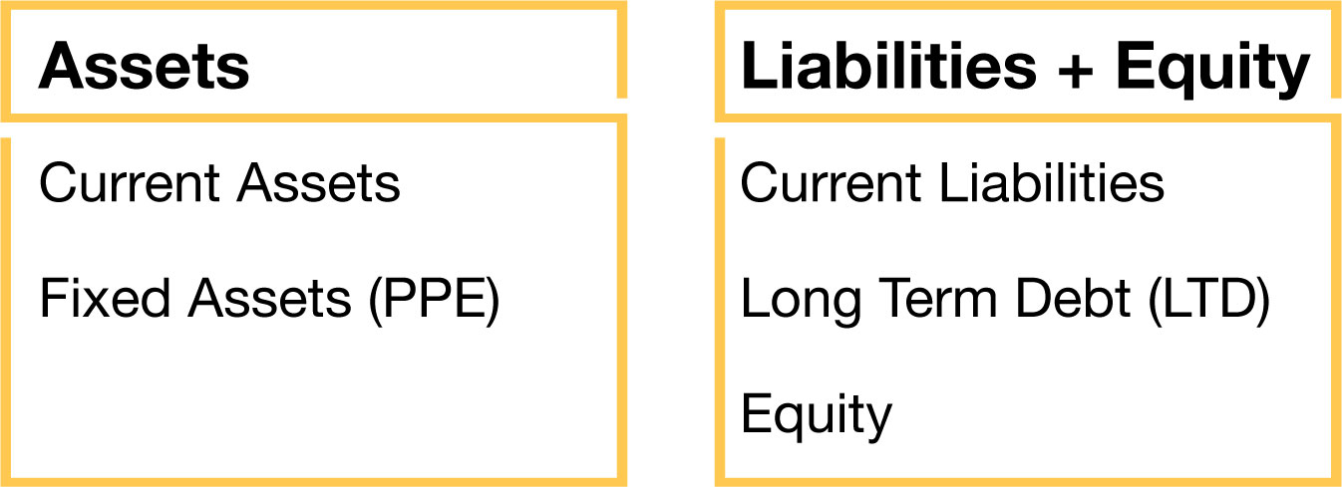
WACC = The Required Return for Assets
Investing Decision
Financing Decision
Notes:
In finance, we view the balance sheet as assets and the claims against those assets. So the assets produce cash flows (CFS FROM assets) and since the debt and equity are claims against the assets, the CFs produced by the assets go TO the debtholders (aka bondholders) and the equityholders (aka stockholders)

Slide 4
WACC
Weighted average cost of capital, or WACC
WACC = E/(V) * R_{E} + D/(V)*R_{D} (1-T_{c})
V = E + D
E/V = weight on equity
D/V = weight on debt
R_{E} = required return for equityholders
R_{D} = required return for debtholders
T_{c}= marginal tax rate

Slide 5
Inputs to WACC
D = Market value of debt
Price of one bond x Bonds outstanding
Practical way to obtain
Book value of debt (par) x Price in %
Suppose book value of debt is $452.38 million and the price is 105% of par
MV Debt = 452.38 x 1.05 = $475 mil

Slide 6
Inputs to WACC
E = Market value of equity
Price/share x Shares outstanding
Suppose the firm has 35 million shares outstanding and the price/share is $20
E = 35 mil x $20 = $700 mil
Both price and shares should be as of the same date

Slide 7
Required Return to Equity, R_{E}
The model we will focus on is the Capital Asset Pricing Model (CAPM)
R_{E (j)} = R_{f} + β_{j} (R_{m} – R_{f})
R_{f} = Risk-free security
Β_{j} = Beta for stock j, measured from regressing stock j’s stock returns on the market’s returns
R_{m} – R_{f} = Market risk premium

Slide 8
Required Return to Equity, R_{E}
Suppose the 30 year treasury is yielding 2.5%. The firm’s beta is 1.2, and the market risk premium is 5%
According to CAPM,
RE = 2.5% + 1.2 (5.0%) = 8.50%

Slide 9
Required Return to Debt, R_{D}
The cost of raising the next dollar of debt is the debt’s YTM
Why not the coupon rate?
Most firms have multiple pieces of debt, but WACC only has ONE “R_{D}”
Weighted average YTM

Slide 10
Required Return to Debt, R_{D}
Debt issue | MV debt (Mil) | Weight | YTM | Weight x YTM
#1 | 100 | 0.21 | 5.00% | 1.05%
#2 | 250 | 0.53 | 4.75% | 2.52%
#3 | 125 | 0.26 | 5.25% | 1.37%
Totals | 475 | 1.00 |  | 4.94%

Slide 11
Putting it all Together, WACC
Corporate tax rate is 40%
What is WACC?
D = $475 mil; E = 35 mil x $20 = 700 mil
D/V = 475/1175 = 0.40
E/V = 700/1175 = 0.60
WACC = E/(V) x R_{E} + D/(V) x R_{D} x(1-T_{c})
= 0.60 x 8.5% + 0.40 x 4.94% x (1-0.4)
= 6.29%

Slide 12
Summary

